Slide 1


React Native quick start

Slide 2

MEET REACT NATIVE
React Native is a JavaScript framework for writing real, natively rendering
mobile applications for iOS and Android.
It’s based on React, but instead of targeting the browser,
it targets mobile platforms.
Notes:
https://www.couponhippo.in/blog/reasons-to-choose-react-native
https://www.safaribooksonline.com/library/view/learning-react-native/9781491929049/ch01.html

Slide 3

WHAT IS REACT NATIVE
Similar to React for the Web, React Native applications are written using a mixture of JavaScript and JSX.
But…
No HTML, JSX components instead
cross-platform: View, Text, Image, Picker
platform specific: TabBarIOS, ToolbarAndroid etc.
No CSS, only CSS-like styles + Flexbox
No DOM API at all
Notes:
https://www.safaribooksonline.com/library/view/learning-react-native/9781491929049/ch01.html

Slide 4
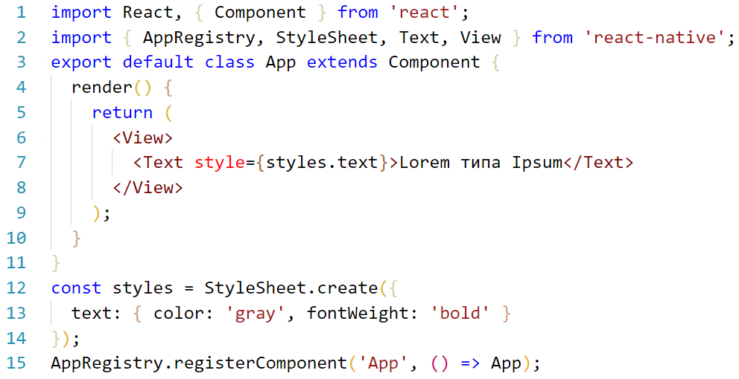
HEY, SHOW ME THE CODE
Notes:
https://facebook.github.io/react-native/docs/style.html

Slide 5

WHAT IS REACT NATIVE
React Native bridges JS calls to the native APIs in Objective-C or Java.
Rendering is performed using real mobile UI components, with look and feel like any mobile application.
Platform features like the phone camera, or the user’s location are accessible through JS interfaces.
As most of the code can be shared between platforms, React Native makes it easy to develop for both Android and iOS simultaneously.
We didn't aim for code sharing between platforms when working on the iOS Ads Manager but expected it could be a nice side effect of using React Native. When the Android Ads Manager was ready to ship, we realized that about 85% of the code was shared between the two apps.
Notes:
https://www.safaribooksonline.com/library/view/learning-react-native/9781491929049/ch01.html
TODO: iterative list

Slide 6
NATIVE VS CROSS-PLATFORM NATIVE
APPROACH
ADVANTAGES
DISADVANTAGES
NATIVE DEVELOPMENT
Best performance
Best user experience
Most conformance to UI guide lines on each platform
Easily customizable
Longer timeline and effort for development
In post-delivery support one developer required for each platform
No code reuse
CROSS-PLATFORM NATIVE
Shared business logic code
Same language used for all platforms
Faster release/bug-fix cycle due to OTA updates
Single developer can support both platforms on post-delivery phase
Better development experience
Potential performance problems doing “heavy lifting”
Effort to create plugins if some native API doesn’t exist
Single thread due to JavaScript
Notes:
Native Script is Angular based and proposed the “use our components” approach instead of “write your own components”

Slide 7
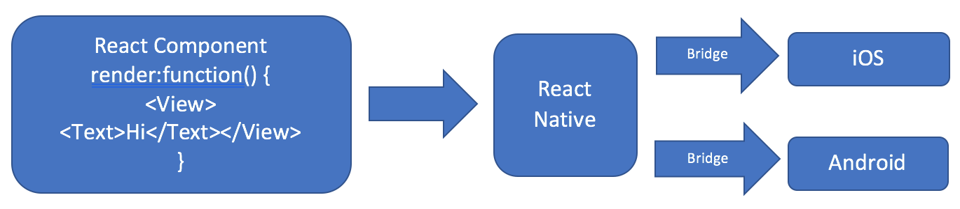
REACT NATIVE HIGH-LEVEL ARCHITECTURE

Slide 8
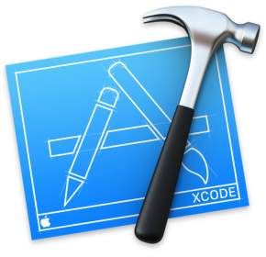



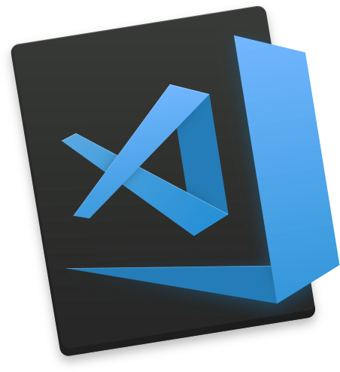






MAIN TOOLSET
IOS (Swift, Objective-C)
Android (Java, Kotlin)
Hybrid (React Native)
Notes:
TODO: Update layout, rethink this slide – split dev tools and recommendation

Slide 9






SOME POPULAR APPS BUILT ON REACT NATIVE
Facebook
iOS · Android
Instagram
iOS · Android
EPAM Events Mobi
iOS · Android
Skype
iOS · Android
Tesla
iOS · Android
Baidu Mobile
iOS · Android
Notes:
https://facebook.github.io/react-native/showcase.html

